Slide 1
The Bulk Forming Processes: Rolling and Forging
Lecture 14

Slide 2
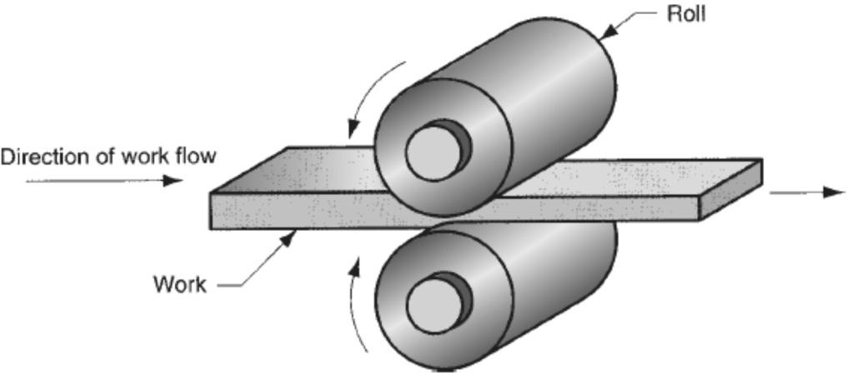
Rolling Process
Rolling is a metal forming process in which the thickness of the work is reduced by compressive forces exerted by two rolls rotating in opposite directions.
Important terminologies:
Bloom: It has a square cross-section, 150 mm x 150 mm or more.
Slab: It is rolled from an ingot or a bloom and has a rectangular cross-section of 250 mm width or more and a thickness of 40 mm or more.
Billet: It is rolled from a bloom and is square in cross-section with dimensions 40mm on a side or more.
Flat rolling

Slide 3
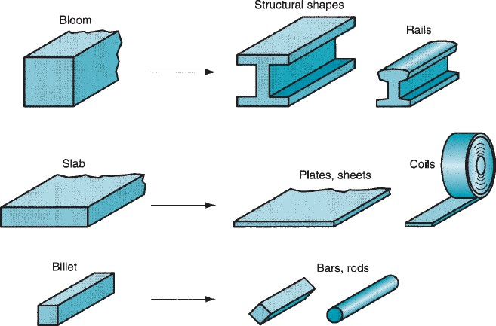
Blooms are rolled into structural shapes like rails for railroad tracks.
Rolling Process and Applications
Billets are rolled into bars, rods. They become raw materials for machining, wire drawing, forging, and extrusion, among other processes.
Slabs are rolled into plates, sheets, and strips. Hot-rolled plates are commonly used in shipbuilding, bridges, boilers, and welded structures for various heavy machinery, as well as in the production of many other products.
The plates and sheets are further reduced in thickness by cold rolling to strengthen the metal and permit a tighter tolerance on thickness.

Slide 4
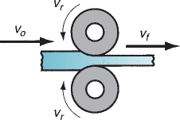
Rolling Mills
Two High Rolling Mill
This type of rolling mill consists of two rolls rotating in opposite directions.
Roll diameters: 0.6 to 1.4 m
Types: either reversing or non-reversing.
Non-reversing mill: rolls rotate only in one direction, and the slab always moves from the entry to the exit side.
Reversing mill: direction of roll rotation is reversed, after each pass, so that the slab can be passed through in both directions. This permits continuous reductions to be made through the same pairs of rolls.

Slide 5
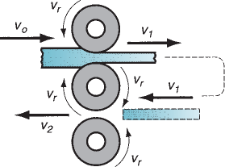
Three High Rolling Mills
For a single pass, two rolls are used.
The roll direction can not be changed.
The top two rolls are used for the first reduction, and the sheet is shifted to the bottom two rolls, and further reduction is done.
Disadvantage: an automated mechanism is required to shift the slab

Slide 6
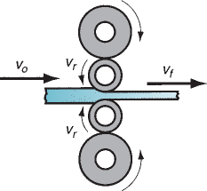
Four High Rolling Mill
This consists of two small rolls for thickness reduction and two large backing rolls to support the small rolls.
The small rolls will reduce the roll force required as the roll-sheet contact area will be reduced.
The large backing rolls are required to reduce the elastic deflection of small rolls when the sheet passes between them.
Four high rolling mills

Slide 7
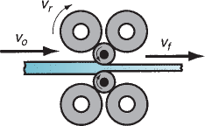
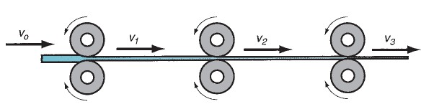
Cluster Rolling Mills uses small rolls for rolling purposes
Tandem Rolling Mill
Consists of a series of rolling stations of the order of 8 to 10.
In each station, thickness reduction is given to the sheet. With each rolling station, the work velocity increases.
Fully used in industry practice, along with the continuous casting operation.
Results in a reduction in floor space and shorter manufacturing lead time.

Slide 8
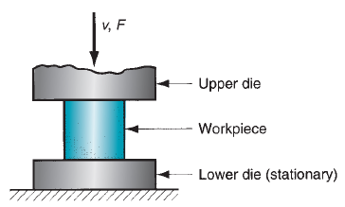
Forging Process
A deformation process in which the workpiece is compressed between two dies, using either impact load or hydraulic load (or gradual load) to deform it.
It is used to make a variety of high-strength components for automotive, aerospace, and other applications. The components include engine crankshafts, connecting rods, gears, aircraft structural components, jet engine turbine parts, etc.

Slide 9
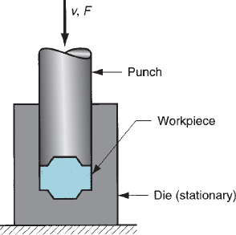
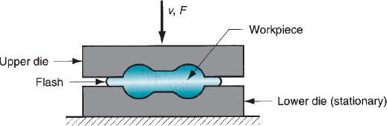
Classifications of Forging
Based on temperature:
(a) cold forging, (b) warm forging, and (c) hot forging
Based on presses:
(a) impact load => forging hammer; (b) gradual pressure => forging press
Based on the type of forming:
(a) Open die forging, (b) impression die forging, (c) flashless forging
Open die forging
Impression die forging
Flashless forging

Slide 10
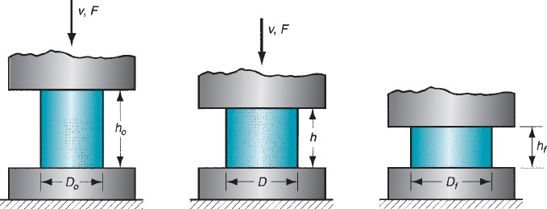
Open Die Forging
A simple example of open die forging is the compression of a billet between two flat die halves, which is like a compression test. This is also known as upsetting or upset forging.
Under ideal conditions, where there is no friction between the billet and die surfaces, homogeneous deformation occurs. In this, the diameter increases uniformly throughout its height.
Start of compression Partial compression
Completed compression

Slide 11
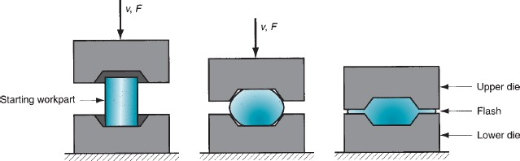
Impression Die (Closed Die) Forging
Closed die forging, called impression die forging, is performed in dies which has the impression that will be imparted to the workpiece through forming.
In the intermediate stage, the initial billet deforms partially, giving a bulged shape.
During the die full closure, the impression is fully filled with the deformed billet and further moves out of the impression to form flash.
In a multi-stage operation, separate die cavities are required for shape change.
In the final stage, actual shape modification is observed. When drop forging is used, several blows of the hammer may be required for each step.
Example: Coining
Starting stage
Intermediate stage
Final stage with flash formation

Slide 12
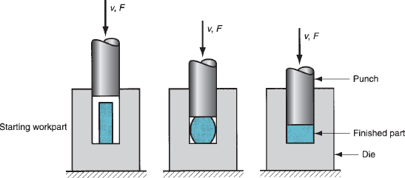
Flashless Forging
Flashless forging: the most important thing is that the workpiece volume must equal the space in the die cavity within a very close tolerance.
If the starting billet size is too large, excessive pressures will cause damage to the die and press. If the billet size is too small, the cavity will not be filled.
Three stages of Flash Forging
Suitable to make simple and symmetrical part geometries, and to work with materials such as Al, Mg, and their alloys.

Slide 13


